Slide 1
SMART MICROGRID USING FACE AUTHENTICATION SYSTEM
CSE7101- Capstone Project
Review-2
Batch Number: CSE_143
Under the Supervision of,
Ms. Swetha Rajagopal
Assistant Professor
School of Computer Science and Engineering
Presidency University
Roll Number | Student Name
20221CSE0216 | Y R Rahul
20221CSE0231 | Darshan Kumar C
20221CSE0242 | J Monesh
Name of the Program: CSE
Name of the HoD: Dr. Blessed Prince
Name of the Program Project Coordinator: Dr. Muthuraju V
Name of the School Project Coordinators: Dr. Sampath A K , Dr. Geetha A

Slide 2
Problem Statement Number:
Organization: Presidency University
Category (Hardware / Software / Both) : Both
Problem Description:
Design and implement a smart microgrid using face authentication system
ensure secure, resilient, and efficient operation under unauthorized access.

Slide 3
Content
Abstract:
The Smart Microgrid Using Face Authentication System provides a secure and automated solution for managing multiple power sources. The system monitors real-time voltage, current, temperature, and humidity using integrated sensors and automatically switches between a transformer and a Li-ion battery for uninterrupted power supply. An Arduino Nano processes sensor data and controls relays, while a Bluetooth module enables wireless load management. Face authentication ensures only authorized users can access and operate the system. The design enhances reliability, safety, and energy efficiency. Overall, the project demonstrates a low-cost, intelligent microgrid suitable for smart home and small-scale energy applications.

Slide 4
Content
Literature Survey:
Key Insights from Reviewed Papers:
IoT-based microgrids require intelligent control & real-time data monitoring.
Sensor-based load management improves energy efficiency.
Bluetooth/Wi-Fi are reliable for local device communication.
Face authentication improves security but must be optimized for low-cost hardware.
Many prototypes lack combined power automation + security + monitoring.
> Objectives:
Automatic selection of best power source (Transformer / Battery)
Real-time monitoring of voltage, current, temperature, humidity
Load control using Bluetooth-based mobile app
Secure access using face authentication
Reliable and continuous power delivery
User-friendly display using LCD (I2C)

Slide 5
Content
Modules
Arduino Nano
Voltage Sensor Module
ACS712 Current Sensor Module
DHT11 Temperature–Humidity Sensor Module
HC-05 Bluetooth Module
ESP32-CAM Face Authentication Module
2-Channel Relay Module
4-Channel Relay Module
16×2 I2C LCD Display Module
Li-ion Battery Module (12V)

Slide 6
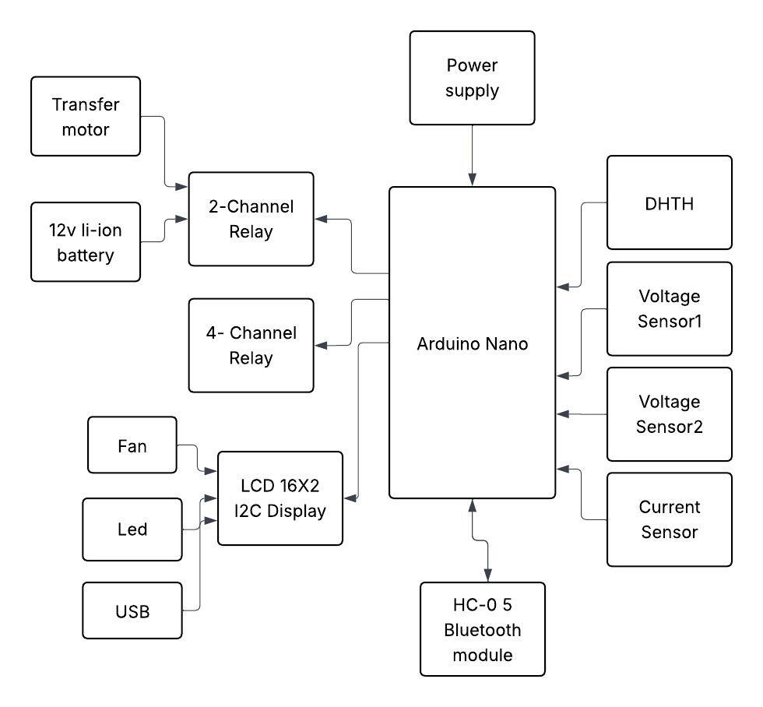
Content
Block Diagram:

Slide 7
Analysis of Problem Statement
Technology Stack Components:
> Analysis of Problem Statement:
Functional Analysis:
The system accurately monitors voltage, current, temperature, and humidity, enabling reliable automatic source switching and secure load control through authenticated access.
Performance Analysis:
Switching between transformer and battery occurs within milliseconds, sensor readings remain stable, and Bluetooth communication provides fast and responsive control.
Security Analysis:
Face authentication restricts system access to authorized users only, preventing misuse and enhancing safety in power management operations.
System Reliability Analysis:
The integration of sensors, relays, and Arduino logic ensures continuous operation even during supply fluctuations, making the microgrid efficient and dependable.

Slide 8
Github Link
The Github link provided should have public access permission.
Github Link
https://github.com/Rahu245/Design-of-Cyber-Security-Enabled-Smart-Controller-for-grid-connected-Microgrid

Slide 9
Analysis of Problem Statement (contd...)
Software and Hardware Requirements:
Hardware Components
Arduino Nano, Voltage Sensors, ACS712 Current Sensor, DHT11 Sensor, HC-05 Bluetooth Module, ESP32-CAM (Face Authentication Module), 2-Channel Relay Module, 4-Channel Relay Module, 12V Transformer, 12V Li-ion Battery, 16×2 I2C LCD Display, Fan, LED, USB Port,Jumper Wires, Power Supply Unit.
Software Components
Arduino IDE, Embedded C/Arduino Language, LiquidCrystal_I2C Library, DHT Library, Serial Communication Library, Python with OpenCV, Mobile Bluetooth Application.

Slide 10
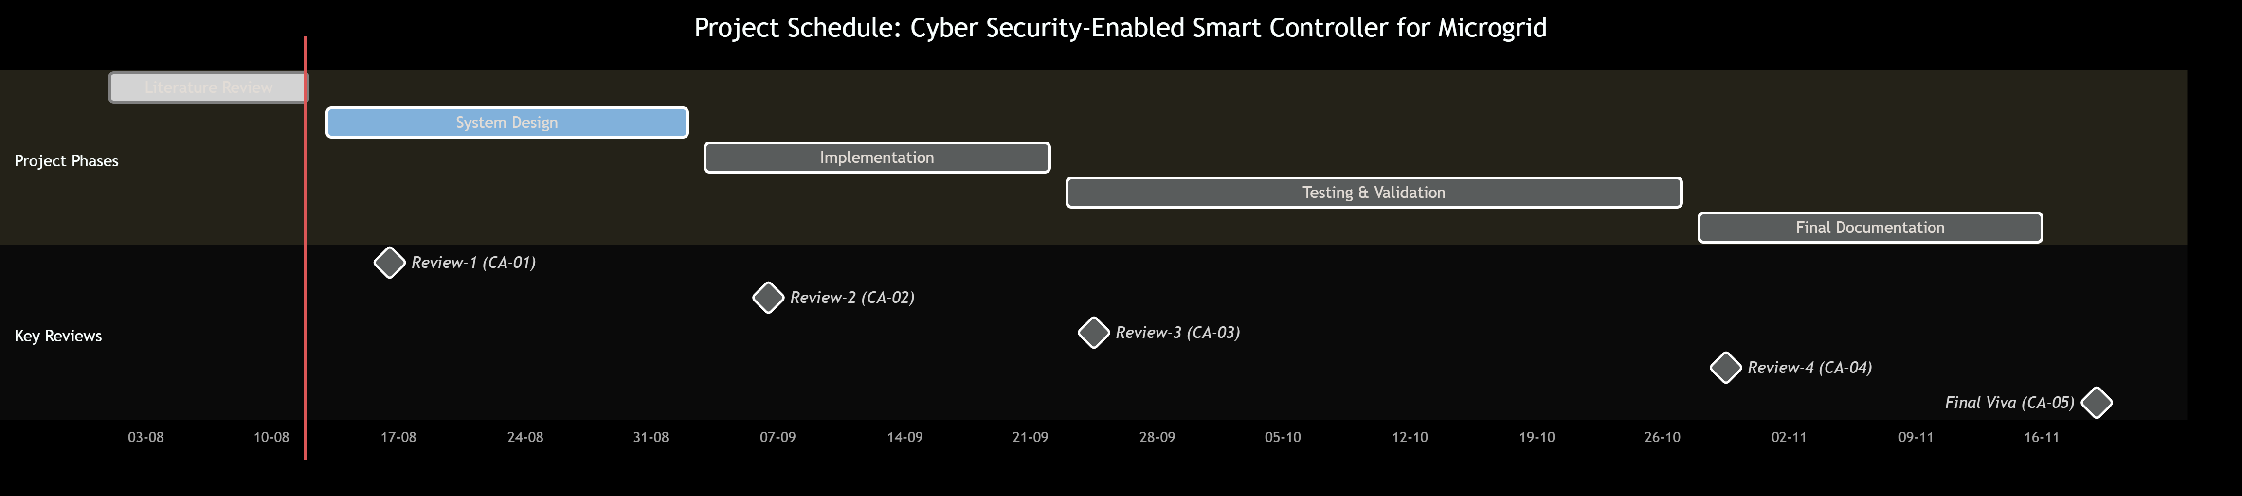
Timeline of the Project (Gantt Chart)
Gantt Chart-

Slide 11
References (IEEE Paper format)
[1] I. Ahmed et al., “Review on microgrids’ design and monitoring approaches,” Scientific Reports, 2023, doi: 10.1038/s41598-023-48985-7. [2] G. Murugan and S. Vijayarajan, “Sustainable energy management system design for microgrids: prototype and validation,” Sustainable Energy Technologies and Assessments, 2023, doi: 10.1016/j.seta.2023.103244. [3] H. Rezk, T. Wang, E. S. et al., “Role of metaheuristics in optimizing microgrids operating and management issues: A comprehensive review,” Sustainability, vol. 15, no. 6, Art. no. 4982, Mar. 2023, doi: 10.3390/su15064982. [4] A. J. Albarakati et al., “Microgrid energy management and monitoring systems: A comprehensive review,” Frontiers in Energy Research, vol. 10, Article 1097858, 2022, doi: 10.3389/fenrg.2022.1097858. [5] Y. Zahraoui, I. Alhamrouni, S. Mekhilef, M. R. B. Khan, M. Seyedmahmoudian, A. Stojcevski, and B. Horan, “Energy management system in microgrids: A comprehensive review,” Sustainability, vol. 13, no. 19, Art. no. 10492, 2021, doi: 10.3390/su131910492.

Slide 12


